Slide 1
CAIP Canada Exam Prep Seminar: Research Designs
Robert A. G. Wong, CAIP, FCRIC
June 2020

Slide 2
Research Designs
Research Designs
Why? Marketing research creates value by helping organizations minimize risk and maximize benefits.
Where to begin by where you wish to end?

Slide 3
Understanding the Project Direction
Research Designs
Iceberg analogy
Explore true reasons for the need for research
Ask questions & more questions
Who needs or would use the results?
What decisions are to be made?
What is the value of the risks of a wrong decision?
What research has been completed before, when, with whom, how, with what insights?
Can internal data be used to answer questions?
Can secondary data be analyzed to answer the question?
What if??
@Adobe Stock
“It’s better to do the right thing than just do things right”

Slide 4
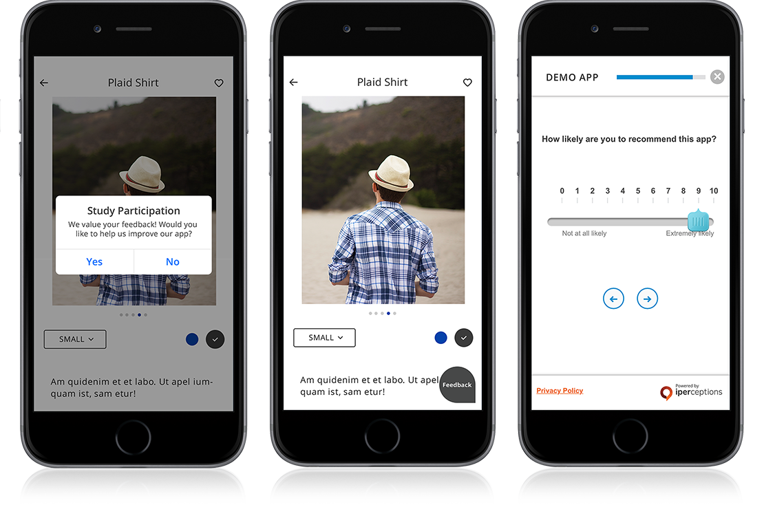
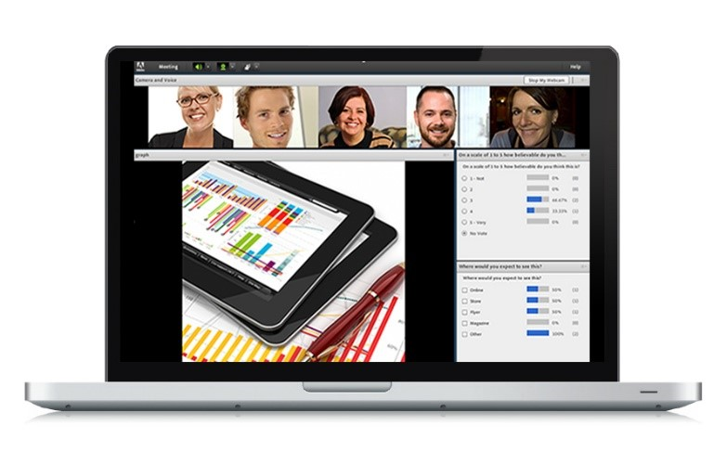
Research Designs
Research Designs
Qualitative
Small number
Need in-depth information about an issue
Exploratory
Unsure of the options
Need to understand perceptions
Explore the range of ideas not to identify the most preferred
Examples: observations, live & online focus group discussions, mystery shopping, in-depth interviews, ethnographic interviews
Quantitative
Large number
Need the number
Conclusive factual information
Know the possible options but need to know preference
Dig into the data for patterns and comparisons of sub-groups
Examples: Web-based, mobile, telephone interviews (CATI), mail self administered, personal interview, big data

Slide 5
Research Designs Classification
Research Designs
Qualitative
Research Design
Quantitative
Exploratory Research Design
Conclusive Research Design
Lit Review
IDI
Focus Groups
Mystery Shopping
Case Studies
Observation
Descriptive Research
Causal Research
Experiments
Ethnographic studies
Blogs, diaries, virtual worlds
Cross-Sectional Design
Longitudinal Design
Single Cross-Sectional Design
Multiple Cross-Sectional Design
Omnibus

Slide 6
Survey Research Methods Comparison
Research Designs
Survey Method | Info Quality | Respondent Convenience | Response Rate | Contact Info | Turn-around | Bias | Data Entry | Cost
Online Computer | moderate | moderate-high | moderate to high | no – client data base | high | moderate | easy | low
Online Mobile | moderate | high | moderate-high | yes | high | moderate | easy | moderate
Self-admin Mail (scannable) | moderate | high | low to moderate | yes | moderate to low | moderate to low | easy | moderate
Interview Telephone (land & mobile) | moderate | moderate to low | low to moderate* | yes | moderate | moderate to low | easy | high
Face to face intercepts (tablets) | moderate | moderate to low | moderate | no | moderate - low | moderate | easy | high
* Based on expanding the sample to achieve desired sample size

Slide 7
Other Designs
Research Designs
Omnibus
data on a wide variety of subjects collected during the same survey
Syndicated
studies designed & executed to fill a need (media, technology, food services etc). Then results are sold.
Research/Insight Communities
group of people recruited by a company/organization specifically for providing input on a regular basis
Experimental Design
a design to understand whether a stimulus causes a definite effect.
Exercise in Chat:
Choose a topic and search for syndicated studies
Who, how often, what type of questions could be answered from reports?
Share examples of consumer-oriented companies who have built research communities
How are participants recruited, how often are they asked to contribute, what are the benefits to the business/organization?

Slide 8
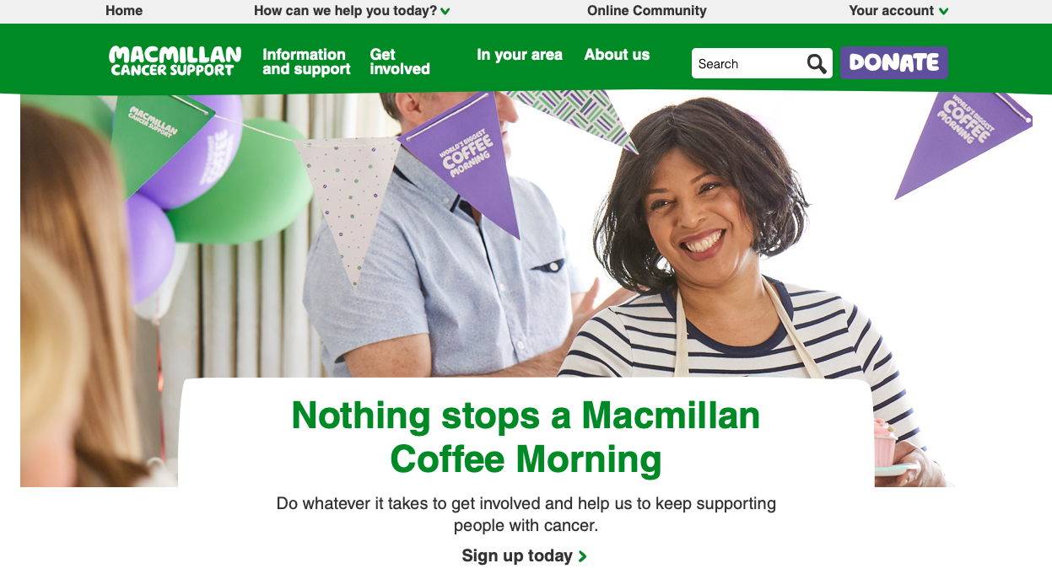
Research Communities/Online Panels/Insights Communities
Greenbook Directory definition:
“Find leading companies who build market research online communities. A market research online community is a targeted group of people who are recruited into a private online venue to participate in research-related activities over an extended period of time.”
Check out these case studies to learn more
Podcaster bringing personas to life
MacMillian Cancer Support reaches out to Patients living with cancer

Slide 9
Qualitative Methods Comparison
Research Designs
Method | Info Quality | Participant Convenience | Turn-around | Bias | Analysis | Cost
Observation | moderate | high | moderate to slow | moderate to high | moderate | moderate
In-depth interviews | high | moderate | slow | moderate to low | more difficult | high
Focus groups (live) | moderate to high | moderate to low | moderate to slow | moderate to low | more difficult | high
Focus groups (online) | moderate to high | moderate | moderate to slow | moderate to low | moderate | moderate
Emerging techniques- blog, Twitter | ? | ? | ? | ? | ? | ?

Slide 10
Market and Competitive Intelligence
Research Designs
Market Intelligence
Internal or external data that could be analyzed for insight
Understand customers & behavior
Customer focused
Examples: consumption patterns, segmentation profiles,
Competitive Intelligence
Information about a competitor or comparable business or organization
Understand company strengths and weaknesses by comparing with key competitors
Business focused
Examples: Market share, brand identity, strategies & tactics
Ethical Considerations:
Use information sources within the public domain
Can’t misrepresent your identity
Document and disclose source of information
Abide by confidentiality agreements of current and past employees

Slide 11
Secondary Data
Research Designs
Wealth of data available
Starting point before primary
Internal vs external data
Internal – big data re-transactions, sales by skews etc
All secondary data critically assessed for:
Value to address gaps
Suitability of data given methodology, currency, data quality and amount of further analysis needed
Data Format– electronic?
BUT must assess the suitability of the data and potential bias
@Laurence Dutton / iStock

Slide 12
Secondary Data
Research Designs
Examples
Statistics Canada
Population, economy, social change measures
Syndicated
Advertising – Vividata, Numeris Canada
Topics such as financial, pharmaceutical, automobiles, fast food & more
Institutes- Environics Institute, Angus Reid Institute
Future opportunities
Mobile data
Mobility data
Social media listening

Slide 13
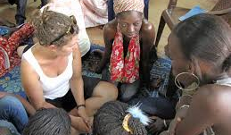
Let’s Put All This to Practice

Slide 14
What’s Up Next?
Quant Methods
Questionnaire Design
Analytics & Insights
Exam
Research Designs
Research Management
Project Proposal &
Critique
Qual Methods
Sampling
Ethics & Standards

