Slide 1
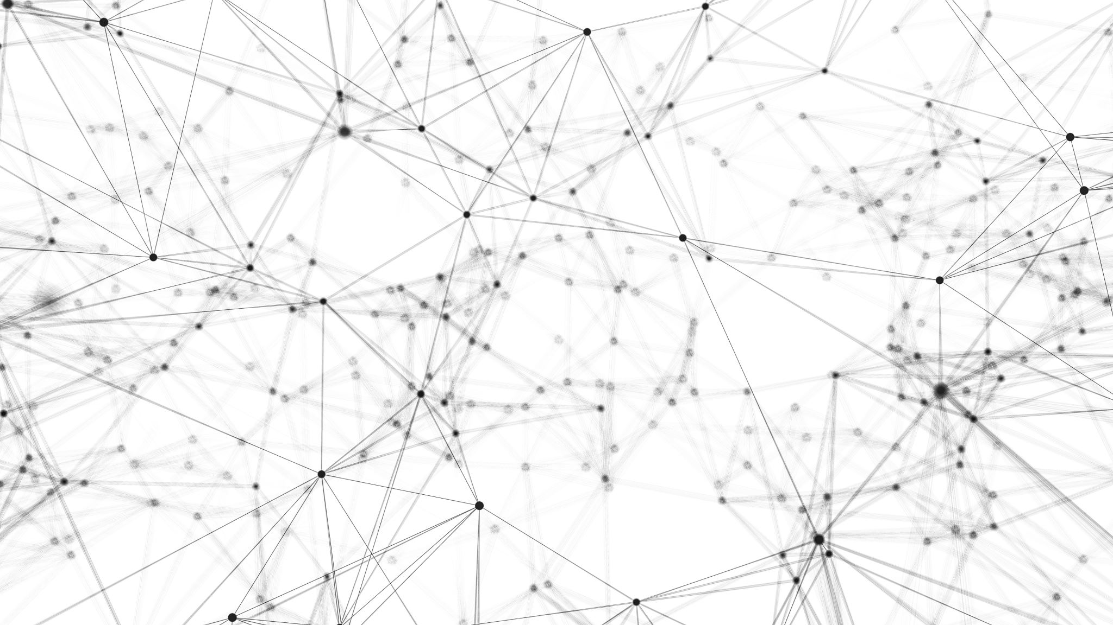
CAIP Canada Exam Prep Seminar: Sampling
Robert A. G. Wong, CAIP, FCRIC
May 2020

Slide 2
Sampling
Sampling: A Mystery
Why sample?
Sampling process
Four steps
Defining population
Identify sample frame
Calculating sample size
Applying sampling procedures
Non-probability
Probability
@JJAVA/Adobe Stock

Slide 3
Sampling
Sampling: A Mystery
Sample – representative portion of the population
Why?
Time efficiency
Budget effectiveness
Reduce non-sampling errors
Ability to conduct further research of same population

Slide 4
Sampling & Non-Sampling Errors
Sampling
Non-sampling errors
Unclear questionnaire wording or skip patterns
Poor interviewing
Respondent fatigue
Language problems
High level of non-response
Omission of eligible respondents from the sample frame
Inaccurate coding or data entry
Sampling not representative of population

Slide 5
Sampling & Non-Sampling Errors
Sampling
Sampling (Random) errors
Studying only portion of population
Mathematically estimated for probability sampling procedures
Cover under sample size estimations

Slide 6
Population & Sample Frames
Sampling
Four Stage Process
Define the Population
Identify Sample Frame
Calculate Sample Size
Apply Sampling Procedure
Define Population
sampling element
sampling unit
extent
time
e.g. Growing Links
Element – food service mgrs
Unit – Broad public sector (education, health etc)
Extent – Lunenburg County, NS
Time – 2020
Identify Sampling Frame
creative part: the ideal vs a compromise
e.g. customer email list, registration list, association list, even a LinkedIn Group + others
Sometimes need to cross reference lists
e.g. farmers, commodity association (e.g. seafood producers, dairy association)
Target population may differ from study population
Limitations defined

Slide 7
Sample Size
Sampling
Sample Size Calculation
n=Z²pq
E²
n=(1.96)²(.5)(.5) .05²
n=(3.84)(.25)
.0025
n=.96/ .0025
n=384
Suppose… you want to calculate the sample size for a project.
Population size is not important beyond 1000
Suppose… the researcher feels that the answer to the question about use of the Internet was 50% (p) in favour
And was willing to accept a confidence interval of +/-5 percentage points ((E) with a 95% (Z) confidence level
Based on the calculation the sample size (n) needed is ~390
BUT… you can work backwards give your sample size and response to a question and the confidence level to calculate confidence interval
n=sample size
Z=confidence level (95%)
p=worst case scenario of what % of pop will respond to a dichotomous question
Q=1-p
E= acceptable confidence interval or margin of error

Slide 8
Sample Size Adjustment for Small Populations
Sampling
If sample is 10% or higher of the population then apply finite population correction
n’=n/[1+(n/N)]
n=original sample size
N=population
So for the example that the population is only 2300
Final finite sample size would be 325 with a margin of error of +/- 5 percentage points, 19 times out of 20 (confidence level)
Small Population
Sample Size Calculation
n’=n/[1+(n/N)
n’=384/[1+(384/2300)]
n’=384/[1+(.1834)]
n’=384/1.1834
n’=325

Slide 9
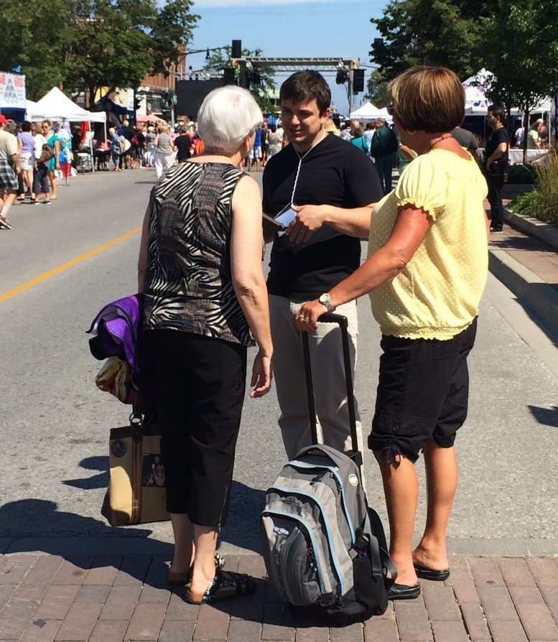
Non-probability Sampling Procedures (don’t know population size)
Sampling
Accidental/convenience
Intercept at convenience of respondent
used extensively & least representative (self selection issue)
least costs & fast
Purposeful/judgemental
select based on another person’s advice
moderate to low use
more research expertise
Quota
believe subgroup representation needed
sample, screen for criteria, sample until quota is met
extensively used
@rmcg

Slide 10
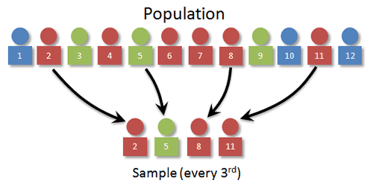
Probability Sampling Procedures
Sampling
Simple random
random number table
equal chance of selection
Systematic
every nth one with a random start
avoid monotonic trend
Clustered
consider how people gather (e.g. meetings, forums, groups, buses)
select the whole group/cluster
no respondent names required

Slide 11
Probability Sampling Procedures
Sampling
Stratified
subgroup representation
calculate % of total pop
proportion sample to represent population
disproportionate: over & under sample weight data (e.g. post graduate students, part time students, regions of Canada)
Multi-stage sampling
combinations (e.g. stratified, systematic)
list in order of execution

Slide 12
Weighting Data
Sampling
Known bias in sample if not representing population:
gender
geography
members vs non-members
low vs high users
program of students
branch offices
Weighting compensates
Beware
need to know variable and bias
consider if sample biased by the more engaged sample & then weighting may exaggerate the known and not represent the unknown

Slide 13
Example: Regional Representation by Geography
Awareness study of regional lifestyle magazine
Telephone interview based on a rented sample
Concerned about representation by geography
Townships | 2019 Pop | Sample needed | % of pop | % of sample | Weight Index
One | 5455 | 138 | 6.9 | 9.0 | .8
Two | 7689 | 195 | 9.7 | 11.0 | .9
Three | 5436 | 138 | 6.9 | 6.1 | 1.1
Four | 8426 | 213 | 10.7 | 10.5 | 1.0
Five | 8044 | 204 | 10.2 | 10.4 | 1.0
Six | 9809 | 248 | 12.4 | 11.5 | 1.1
Seven | 10448 | 265 | 13.2 | 12.5 | 1.1
Eight | 8993 | 228 | 11.4 | 11.9 | 1.0
Nine | 6161 | 156 | 7.8 | 7.3 | 1.1
Ten | 8504 | 215 | 10.8 | 9.8 | 1.1
Region | 78965 | 2000

Slide 14
Your Turn Next! Practice Questions

Slide 15
What’s Up Next?
Quant Methods
Questionnaire Design
Analytics & Insights
Exam
Research Designs
Research Management
Project Proposal &
Critique
Qual Methods
Sampling
Ethics & Standards

