Slide 1
CAIP Canada Exam Prep Seminar: Research Designs: Case Study
Robert A. G. Wong, CAIP, FCRIC
June 2020

Slide 2
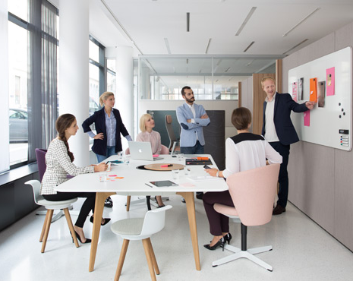
Research Designs
Research Designs
Review a case study
Discuss components
Examine keys to success of proposal development/critique
Your turn to practice
More learning with other modules
Live proposal feedback

Slide 3
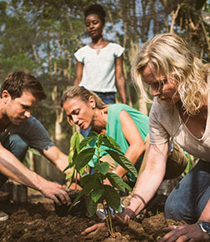
Global Links Baby Boomer Market Feasibility RFP
Global Links is a Canadian adventure tour company that has enjoyed a comfortable market share for those adventure travelers in Millennial to the Baby Boomer segments in North America. In the past 8 years Global Links has been successful to grow into a large travel product called Voluntourism. A market of well-educated and under employed Millennial has sought to experience the world and gain experience. They travel; they volunteer with a community project in a developing country. They contribute to a global need and grow personally from the experience. Global Links designs packages that range from $1000-$5,500 for a 2 week to 2 month package.
Global Links has sought your advice to examine the market opportunities to expand this concept among the retiring baby boomers that have time, expertise and financial means. From long conversations with his past clients, Justin, believes the core values and motivations for volunteerism would be strong but is unsure of types of volunteer experiences that might match their expertise and interests. He likes the qualitative side of research but is inexperienced with the quantitative side. What would you recommend in the way of research for his business decision?

Slide 4
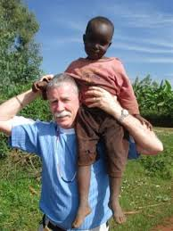
Describe the Research Design
Research Designs
A four phase descriptive conclusive study of baby boomer retirees or soon to be retirees about their interests in Voluntourism. Phase One, consists of mining the Global Links CRM to better understand this segment in terms of current size, growth & client feedback. Phase Two, involves some competitive intelligence of two travel groups offering volunteer experiences. Utilizing the results from Phase One and Two, Phase Three consists of large quantitative online panel with Canadian baby boomers to capture their volunteer interests, past travel experiences, skill sets to share and necessary amenities of travel and accommodation. Following the quantitative study, Phase Four, will dig deeper to explore reactions to scenarios of volunteer experiences and then trip packages. An extended online discussion community will be employed to hear the richness of conversation.
Phase One:
MI Global Links Boomer Clients
Phase Three:
Cdn Boomer Online Panel
Phase Two:
CI of Two Travel Groups
Phase Four:
Online Community

Slide 5
Proposal Dissection
Research Designs
Background
Who & What: Global Links, Travel Experts specializing in Voluntourism experiences
Research issue/opportunity: needs to understand the feasibility of expanding their voluntourism product to Baby Boomer segments
Research purpose:?
Overall Design:
A multi phase descriptive conclusive study of Canadian Baby Boomers about their interest in voluntourism experiences offered by Global Links.

Slide 6
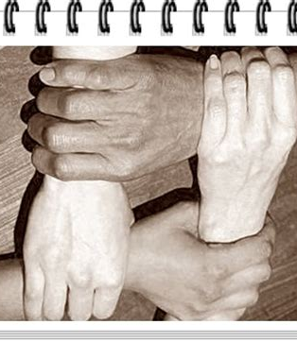
Proposal Dissection
Research Designs
Phase 1: Data Mining the CRM of Global Links Boomer Clients
Objective: document the size, characteristics, product purchases, experience feedback of the Boomers clients of Global Links
Rationale of method & sample: WHY???
Best to start with internal market intelligence
Inexpensive method to set the context of this segment
Past post-trip feedback surveys available to further analyze
Can examine trends in size of segment and rating of experiences over past 5 years
Considerations of standards WHY??
All internal, if outsources for analysis need signing of non-disclosure and guidelines about use of data, removal of personal information from CRM
Outcomes of analysis:
Size of current Boomer segment, trends over past 5 years
Thematic analysis of feedback about past packages – price, volunteer experiences, type of amenities

Slide 7
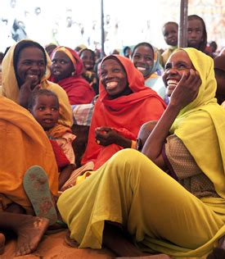
Proposal Dissection
Research Designs
Phase 2: CI of Other Travel Groups
Objective: examine best practices of two competitors in Voluntourism: in US and Europe
Rationale of method & sample: WHY???
Learn best practices or areas to avoid from competitors
Information publically available though company web sites, blogs, discussion groups
Why 2? Could expand to 3, initially screen for most aligned with Global Links
Considerations of ethics WHY??
Only publically available sources
Can seek information (brochures, pricing etc) from companies as consumers
Outcomes of analysis:
Learn, if and how, competitors market to boomers
Key messaging
Components related to volunteer experiences and amenities
Identify who else competes in the Canadian market place
Who might be strongest competitor

Slide 8
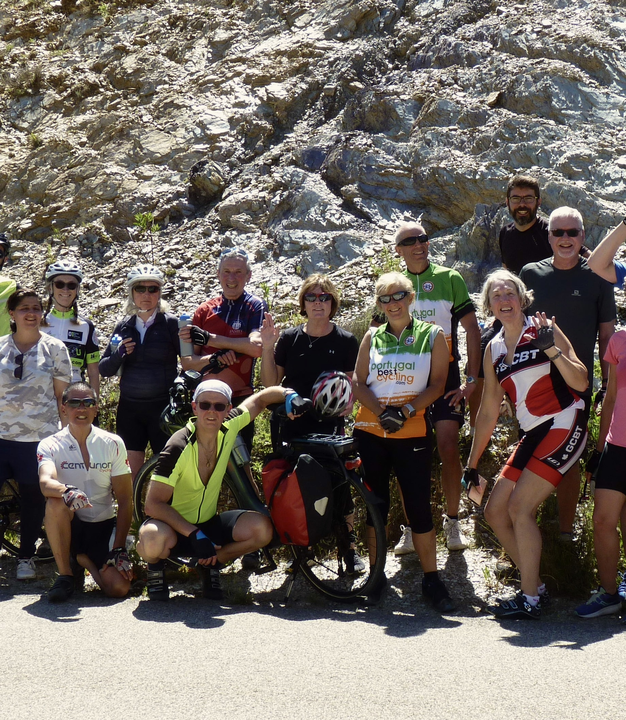
Proposal Dissection
Research Designs
Phase 3: Quantitative online panel survey of Canadian baby boomers
Objectives: determine the level of interest in Voluntourism, Establish size of the market in Canada
Understand the key motivations of boomers to Volunteer
Capture needs and preferences of travel amenities
Rationale of method & sample: WHY??
Define population, sample size, procedure & limitations
Describe method
Online Cdn panel, evaluate best panel based on boomer segment size, past travel, retirees, more urban mix across Cdn, multi-cultural, size at least 2000 completes
Best for geographic coverage, fastest turn around, can filter for best sample presentation
Survey allows for quantitative measures
Consideration of Standards: WHY?? sample size, non-probability sampling cannot be projected to population, request permission for follow up research
Outcomes of analysis: cluster analysis, gap analysis, conjoint possibly, segmentation of boomers, top desired volunteer experiences, preferences for destinations, time frame, length, issues & challenges regarding amenities WHY??

Slide 9
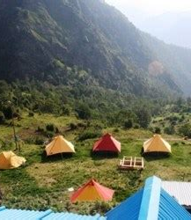
Proposal Dissection
Research Designs
Phase 4: Qualitative Community
Objectives: explore deeper into volunteer experiences and amenity packages
Rationale of method & sample: WHY??
Describe method
Great opportunity to build cross conversations among those who have done voluntourism experiences and those who would like to, ability to probe deeper
Recruit boomers from quant phase, 4 groups of 6-8 boomers, discuss homogenous vs heterogeneous groups volunteers and want to be volunteers, community to continuously seek feedback on new ideas
Consideration of Standards: WHY?? screen for past participation in qualitative groups, disclose use of first name only, use of their comments for reporting or testimonials, discuss nurturing engagement and compensation for participants
Discussion of analysis: thematic content analysis of transcripts using NVivo software to understand volunteer motivations, etc WHY?? Relate back to objectives
Deliverables
???

Slide 10
Keys to Success
Research Designs
Why? Why? Why?
Defend your methodology!

Slide 11
What did you take away?
Research Designs
Keys to Success
Understand the client and business/organization
Identify the research issue/opportunity
Clearly state purpose and about 4 precise objectives
Describe/critique methodology concisely with method & sample defined and a defensible rationale
Must apply methodology to client briefing/request for proposal
Clearly defined outcomes
Time & cost mapped out
@Jnemchinova/iStock

Slide 12
The Request
Write a research proposal to address LocalMe’s business needs. Your proposal should provide a detailed explanation of the hows and whys of your research approach. If assumptions are required for clarity of your proposal, please state and explain the assumptions. In addition, LocalMe realizes that a new product introduction may mean exploring new channels and methods/techniques to gain insight and would entertain them within this proposal if there is strong justification.
In particular, the proposal should include the following sections:
5% Background: Your understanding of the client’s needs
15% Purpose and Objectives: Your understanding of the marketing objectives as well as the research objectives of this project.
50% Project Approach/Methodology: Include a clear explanation of the research phases (Methods/Techniques) and why you have selected this Methodology. The client has asked two other firms to bid and is looking for insights about why your approach is better than other possible approaches/methodologies.
15% Outcomes: Describe the outcomes the client would expect from the research project.
10% Timeline: Three months has been allocated for this project. Please provide a general sense of timing for the various phases and when input is required by the client.
5% Budget: The budget is approximately $100,000. It is not necessary to show detailed costing but it would be insightful to provide the client with major or gross spending categories, and the percentage of the budget that would be applied to each.
@goodluz/iStock

Slide 13
Practice Time Request for Proposal

Slide 14
Examine the Components
Research Designs
Background
Background context
Business/Organization/Marketing problem/opportunity
Research Purpose & Objectives
Research Approach/Methodology
Phase 1: Method1
Design & rationale
Objectives by Phase
Method & sample
Type of ethical & standards considerations
Type of analysis
Phase 2: Methods (as many as NEEDED)
Design & rationale
Relate how Phases inform the other Phases
Objectives by Phase
Method & sample
Type of ethical & standards considerations
Type of analysis
Outcomes
Overall expected insights to original problem/opportunity
Timeline
Weeks and months only
Costs
Order of magnitude only for relative level of effort
Your Practice
Review Case
½ hour to map out project
Add finer points regarding rationale and standards and ethics
Then spend 2 hours to write your proposal
After 2 1/2 hours assess completion status and evaluate where you took too much time and critically evaluate where you have gaps
Plan strategy for exam
Remember quality wins over quantity!

Slide 15
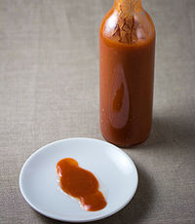
Some Like It Hot! Market Feasibility
Dinner tables today have a new emerging condiment, hot sauce. In fact, hot sauces in the United States had grown so fast in the past 5 years that it is number 1 of the ten top food growth industries in the USA. Some say our adventuresome palates are attributed to our international traveling, maturing cuisine and our new immigrant influences. The hot sauce market size is valued at $2.29 B and expected to grow to $3.77B by 2026 in the USA.
The Canadian palate has proven to be divergent to our US neighbours in so many instances from coffee to chips (e.g. Starbuck’s blonde roast excels in Canada but not in the US; while Lay’s chicken and waffle chips fit in the US). So, LocalMe, a Canadian medium size local food producer wants to enter in the hot sauce market in Canada. But LocalMe is cautious and wishes to examine the Canadian market place. LocalMe feels its uniqueness would be the local food sourcing, small batches with high quality control, exceptional flavour and their online sales system.

Slide 16
Some Like It Hot! Market Feasibility
Some of the questions LocalMe has are:
What formula would work best in Canada?
Is Canada, a one formula market or are there regional differences?
Who would be their key market segments? And what is the market size of these segments?
What can be learned from our neighbours to the south to do and to avoid?
What messages of LocalMe’s uniquenesses will resonate with key markets?
What images on labeling might best position LocalMe’s hot sauce?
Finally, LocalMe has 4 names they wish to test as well to generate attention in the market place and stand out among its competition?

Slide 17
What’s Next?
Research Designs
Peer to Peer Review
Consider what you can produce in 3 hours
Ask yourself
Is your proposal complete?
What could be enhanced?
How well have you related your design to the case study?
If you were the client would you act on the proposal?
How can YOU further prepare for the case study?
Share your submission with fellow candidates for a feedback
Look for the Live Feedback date!

Slide 18
What’s Up Next?
Quant Methods
Questionnaire Design
Analytics & Insights
Exam
Research Designs
Research Management
Project Proposal &
Critique
Qual Methods
Sampling
Ethics & Standards

